Slide 1

From the Classroom to the Workplace
ESSENTIAL SKILLS
MATTER

Slide 2
Essential Skills Work Ready Youth Program
Notes:
This presentation is designed to familiarize you with the essential skills work ready youth workbooks you will complete and to give you opportunities to ask questions.

Slide 3
Overview
The Essential Skills Work Ready Youth Program is the latest essential skills learning tool of Skills/Compétence Canada.
The materials are designed for use by young people interested in exploring the skills they have and in growing the skills they need to have, in order to succeed at work.

Slide 4
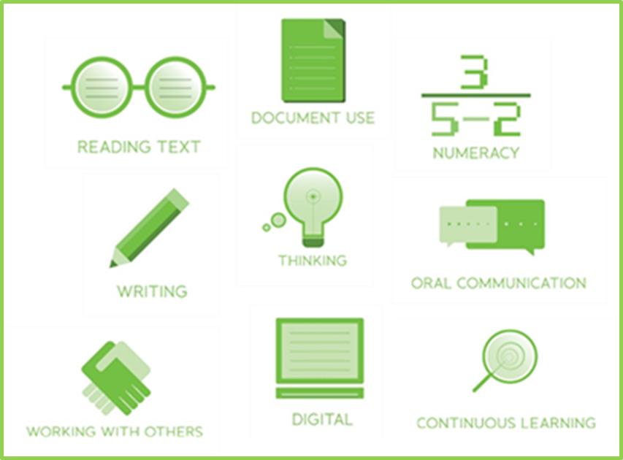
Essential Skills
Notes:
The Government of Canada has identified nine skills considered to be key to the success of individuals at work and in daily life, and to the success of industries and national economic outcomes. The skills are referred to as essential skills.
Research shows that they are skills that all people need for work, learning and life, no matter where they live or what jobs they pursue.
They are skills that are the foundation for learning all other skills. The skills enable people to evolve with their jobs and their lives and to adapt to change in the workplace and in life.
The skills are used, to different degrees, in every job and at different levels of complexity. For example, some jobs require significant amounts of reading, others require very little; however, all jobs require some amount of reading at some point.
The required reading may be basic, such as notes from co-workers, or it may be highly complex, such as repair instructions for complicated equipment.
The level of essential skills required for most trades is as high, or higher, than it is for many office jobs. Having strong essential skills means learners in the trades will be better prepared to understand and remember concepts introduced in technical training.

Slide 5
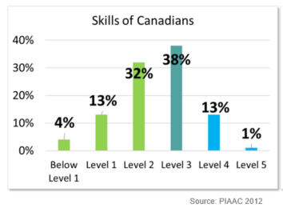
Essential Skills
Notes:
The numbers shown on this slide are a big part of the reason why there is so much concern around helping people to improve their essential skills.
A recent research survey called The Programme for the International Assessment of Adult Competencies (PIAAC) found that 49% of working age Canadians have reading and document use skills that need work.
That’s a lot of people without the skills they need, and it makes a big difference to employers.
Businesses don’t do as well as they could if the employees have low levels of essential skills.
The lack of essential skills means employees don’t learn new processes as easily and they are more likely to make mistakes and to be injured on the job. These factors reduce businesses’ productivity.

Slide 6
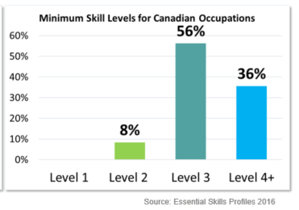
Essential Skills
Notes:
When you look at this slide you can see the disconnect between the skills people have and the skills employers need them to have to be able to work effectively.
Only 8% of occupations in Canada require people with skills at level 2.
The vast majority need people with skills at level 3 and above.
So it is important to help people build their skills.

Slide 7
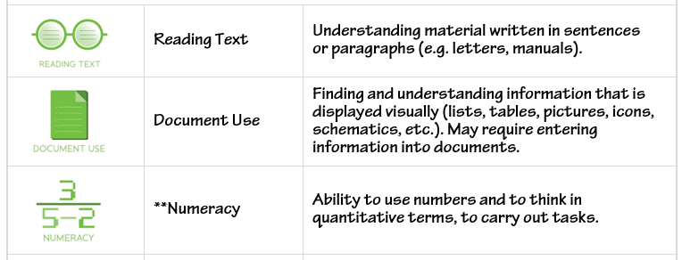
Essential Skills Up Close
Notes:
There are 9 essential skills
(Review the text related to each skill to ensure understanding)

Slide 8
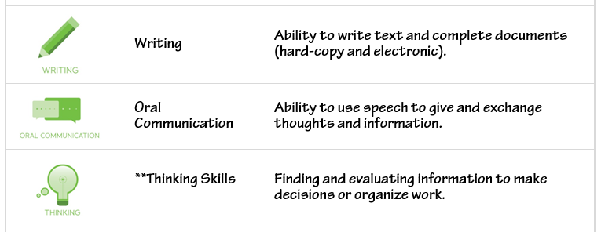
Essential Skills Up Close

Slide 9
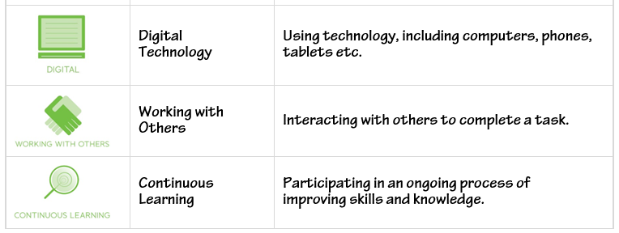
Essential Skills Up Close

Slide 10
Essential Skills Up Close
Numeracy Skills Include
money math
  handling cash, preparing bills and making payments
scheduling, budgeting & accounting
  managing time and money, to plan and track the use of time and money and to assess the value of either
measurement & calculation
  measuring and describing the physical world, such as, size, shape, length, width, height, depth
Notes:
The essential skills of Numeracy and Thinking are broken out into discrete skills

Slide 11
Essential Skills Up Close
Numeracy Skills Include
data analysis
  analyzing numerical information
numerical estimation
  estimating anything that will result in a number
Notes:
The essential skills of Numeracy and Thinking are broken out into discrete skills.

Slide 12
Essential Skills Up Close
Thinking Skills Include
problem solving
  finding solutions for problems that usually concern mechanical challenges, people or situations
decision making
  making a choice among options
critical thinking
  using criteria to evaluate ideas and information in order to make judgements that will have related consequences
job task planning & organizing
  the extent to which the workers plan and organize their own tasks
Main focus of the Thinking Skills workbook
Notes:
Thinking skills are cognitive skills; that is, they are the skills that enable the use of the other skills.
The brain uses this set of skills to accomplish mental tasks. They are the skills we use in school, at work, and in life in general to grasp processes, remember, and apply incoming information.
In addition to the thinking skills described here they include auditory and visual processing and processing speed.

Slide 13
Essential Skills Up Close
significant use of memory
  the use of memory is purposeful, not just something that happens because of repetition. Workers who make significant use of memory, rely on memory in order to successfully complete their work.
finding information
  a thinking skill that is used across all of the other skills, as a component of processes. It is often not possible to solve a problem or make a decision without finding information that clarifies a situation or expands our knowledge of an issue.
Additional important skills. Commonly integrated into use of the other skills.

Slide 14
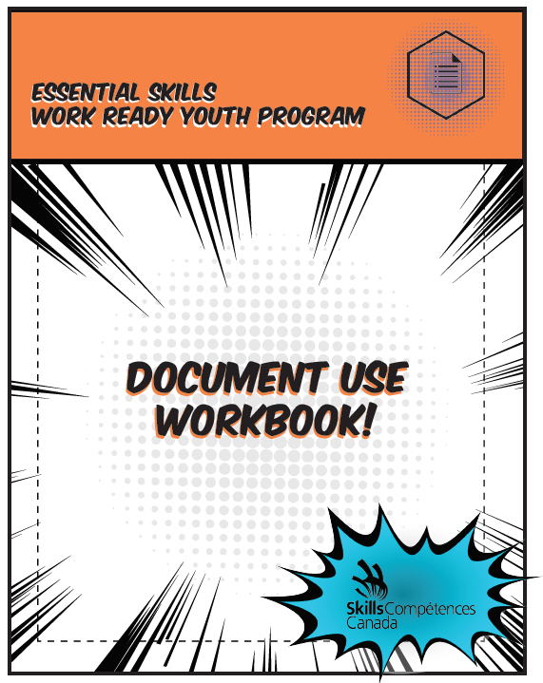
Anatomy of the Workbooks
Notes:
There are eight workbooks in the Essential Skills: Work-Ready Youth Program series. Digital skills are integrated within the workbooks. Each workbook focusses mainly on one of the Essential Skills.
Three of the workbooks will take about 20 hours each to complete. These are Reading, Numeracy and Document Use.
Oral Communication and Thinking Skills will each take approximately 15 hours to complete.
Writing, Working with Others and Continuous Learning will each take about three hours to complete.

Slide 15
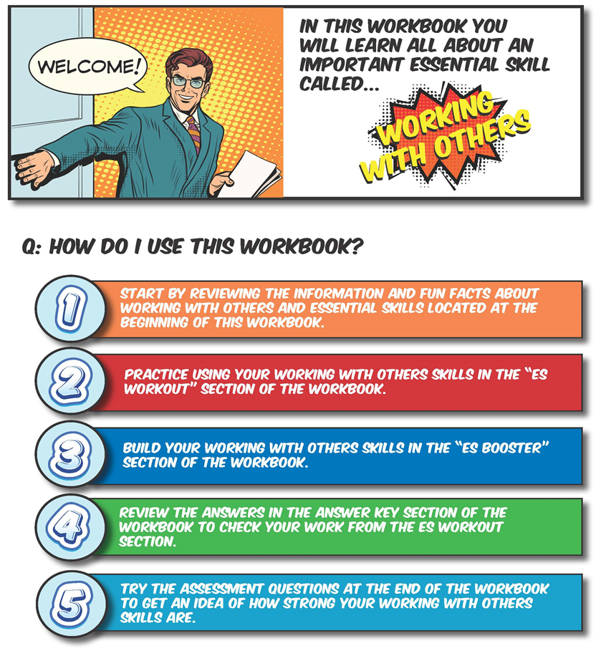
Workbook Sections
Introduction
Notes:
The workbooks are all laid out the same way.
This is the first page of the introduction to working with others. All the first pages look the same.
This page briefly describes how the learner will use the workbook.
(Learners can work through the workbooks on their own or with partners – depending on what works best for your instructional situation. At this point in the presentation, you can tell your learners how you expect them to work on the books.)

Slide 16
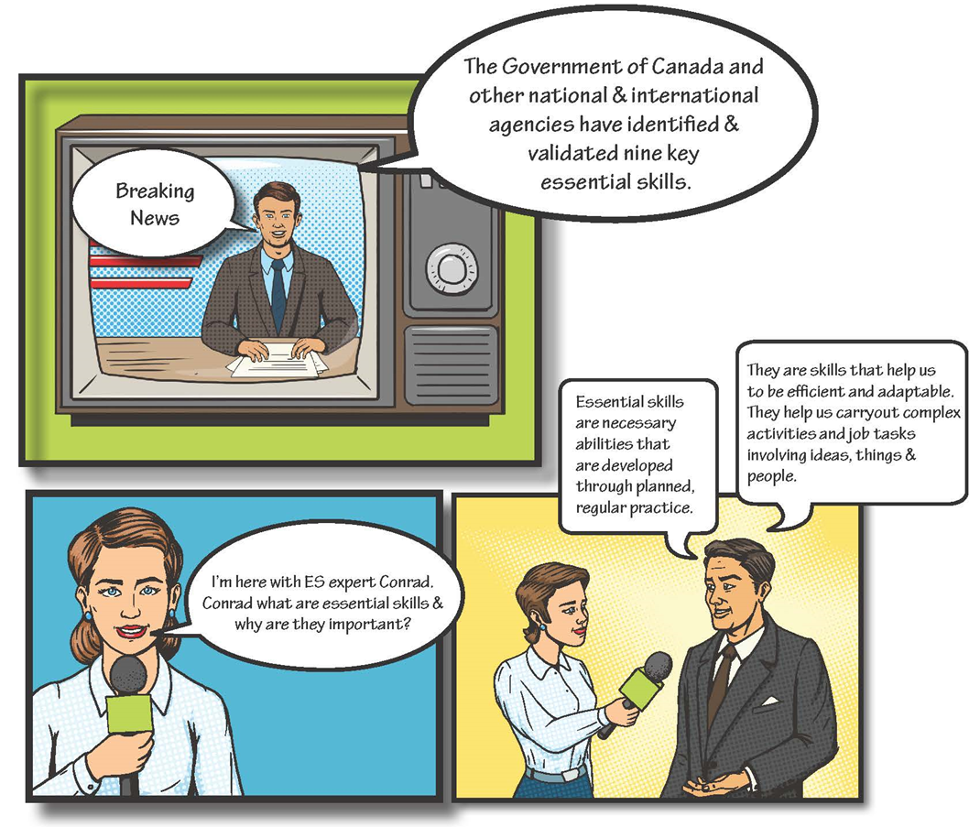
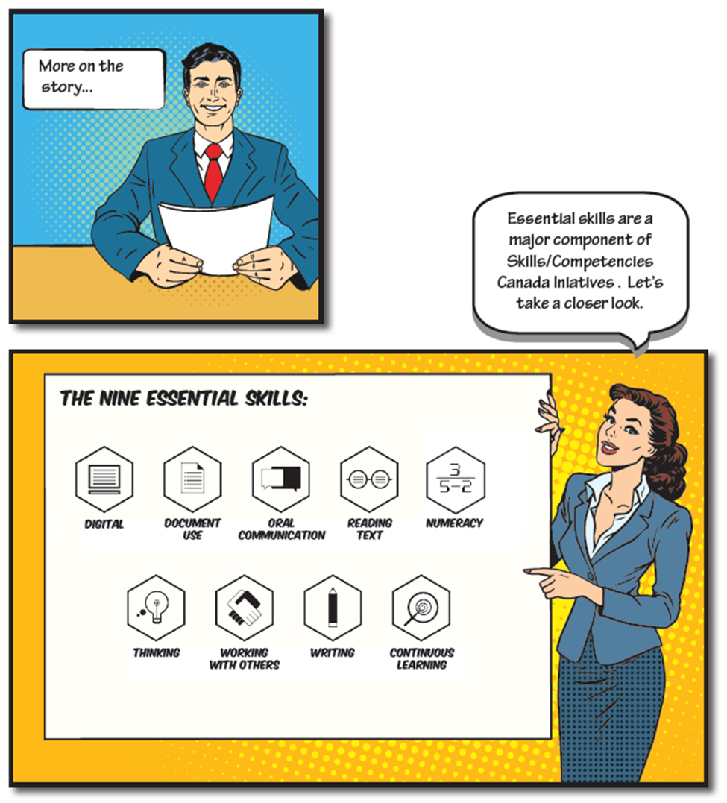
Workbook Sections
Notes:
The next pages in the intro section of each workbook have some basic background information about essential skills.

Slide 17
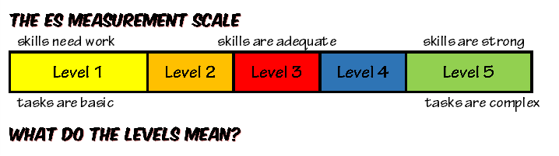
Workbook Sections
Notes:
There is also information about how the skills are measured and what the measurements mean.
Tasks, questions, and problems at Levels 1 and 2 are less difficult than those at Level 3, 4, and 5.
People with essential skills at Levels 1 and 2 need to practice in order to make their skills stronger.
When we have skills at, or above, Level 3 we have skills that are strong enough to enable us to cope with new situations and to efficiently learn academic, technical or job-specific skills.
Employers prefer to have workers who are efficient, capable, learners because they can accurately solve problems, complete their work, learn new processes and adapt to changes on the job.
The skills are just as important in daily life. We all need to read information, fill out documents, make decisions about how much we can spend on things we want to buy, work and communicate effectively with friends, family, teachers and employers, and use computers and other digital technology.

Slide 18
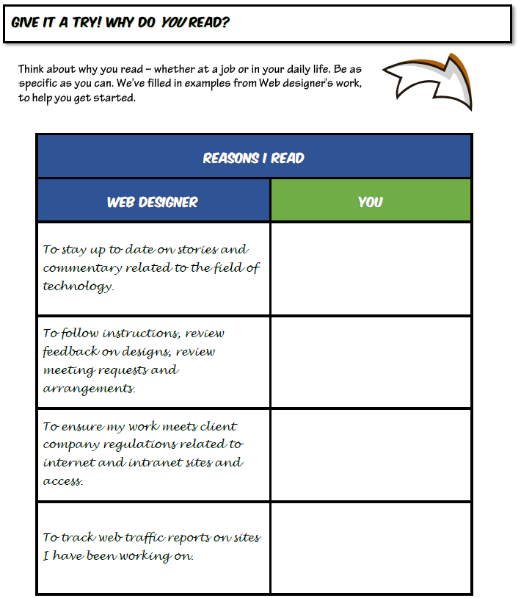
Workbook Sections
Notes:
After the information about measurement, you have the opportunity to try a few introductory tasks related to the skill the workbook is focused on.

Slide 19
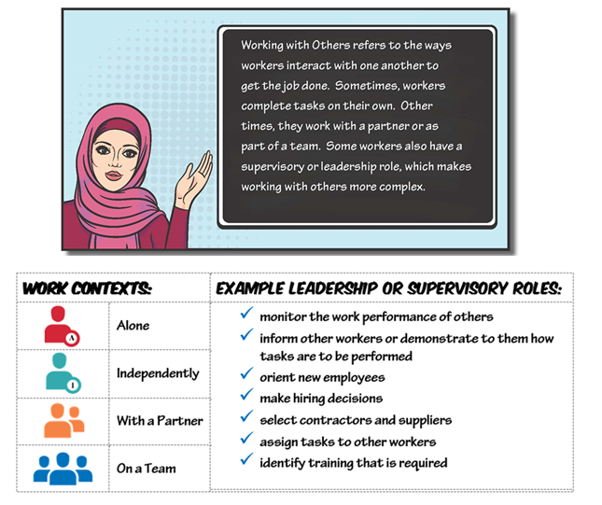
Workbook Sections
Notes:
Next there are a few more details about the skill

Slide 20
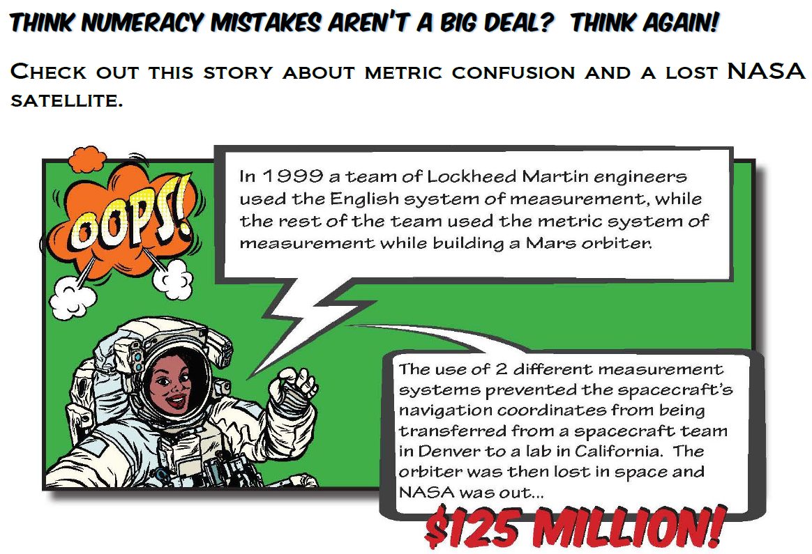
Workbook Sections
Notes:
And some short stories and fun facts about the featured skill in action.
For example on page 13 of the Numeracy workbook you will find a true story about a NASA satellite disaster caused by a measurement conversion error.
The story links to practice with measurement conversions in the workouts.

Slide 21




Workbook Sections
Each workbook has four sections, in addition to the introduction.
In the Answer Keys you will find answers to the tasks you tried in the workouts.
Workouts are essential skills tasks for you to try.
Boosters are short lessons
that will help you build skills.
At the end of each workbook there are a few assessment questions for you to try. Your results will give you an idea as to how strong your skills are.

Slide 22
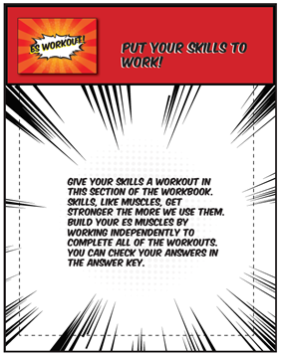
ES Workout
Cover Page
Notes:
The ES Workout sections all have this cover page

Slide 23
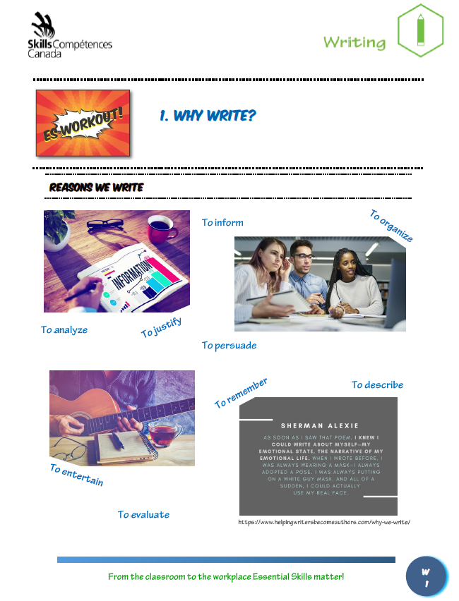
ES Workout
Intro Info
Notes:
Tasks have a page of background information. This is the first page of the first workout in the Writing workbook

Slide 24
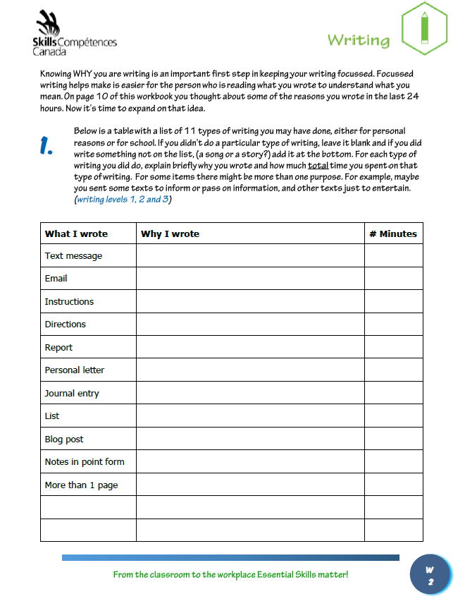
ES Workout
A task to be completed
Task complexity is shown
Notes:
Each task includes an indication of its complexity level, so that you can become familiar with the levels of task difficulty described briefly in the introductory section.
As you can see in the task above, the complexity level is described in blue, just below the question.
In this case a range of complexity is indicated because the tasks you are describing range from easy to more difficult.
For example, if you wrote a report (level 3) that is a more complex task than sending a text message. (level 1 or 2)

Slide 25
ES Workout
EXAMPLE
There is one infographic on each of the next three pages. Look at the first infographic for 10 seconds. After 10 seconds, answer the four questions in the table below, without looking back at the infographic. Then do the same for the other two infographics.
(document use level 3, significant use of memory level 1, writing level 2)
Notes:
Each workbook highlights a particular skill, but because we know skills are often used in combination when they are used to complete real-world tasks, there may be more than one skill indicated. In these cases, tasks are identified first by the skill of focus and then by any additional skills that would be used to complete the task.
The example on this slide is from the Document Use workbook, activity 7, page 62. It is a document use question, but it does require the use of the other skills listed as well.

Slide 26
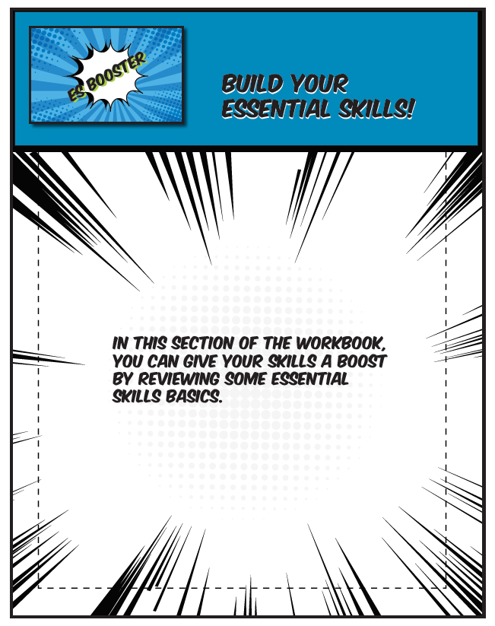
ES Booster
Cover Page
Notes:
The ES Booster sections all have this cover page

Slide 27
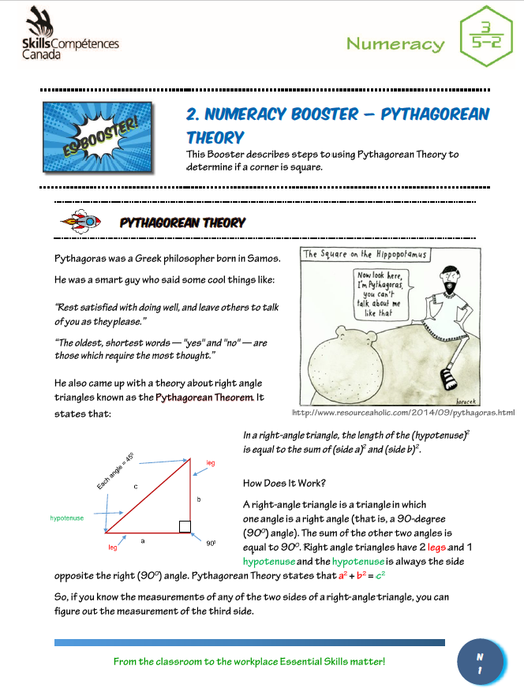
ES Booster
Notes:
The boosters are short lessons on topics that are relevant to the workbook you are working in.
For example, Pythagorean theory is something you need to understand for many of types of work.
There is a booster in the Numeracy workbook that explains the basics of the Theory, and provides some examples.
Understanding the basics, will make it possible for you to apply that understanding in future situations.

Slide 28
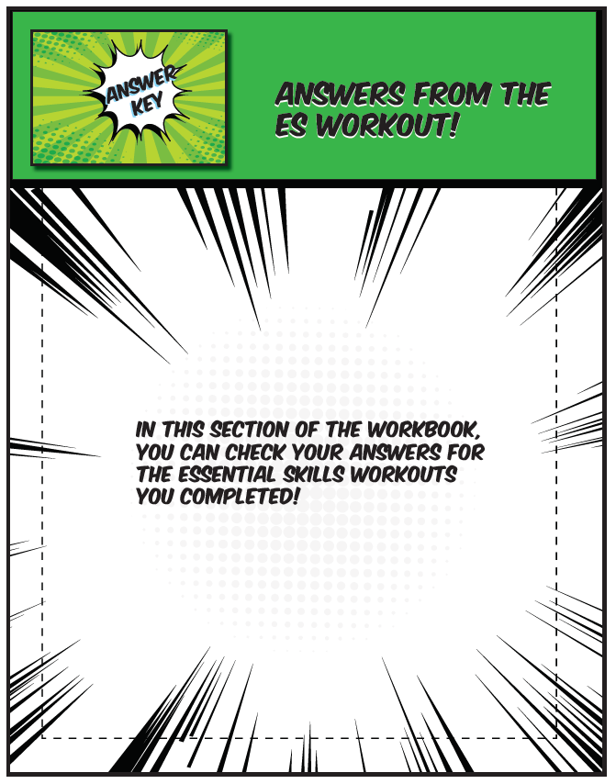
Answer Key
Notes:
Answers to workout tasks are found in the answer keys.

Slide 29
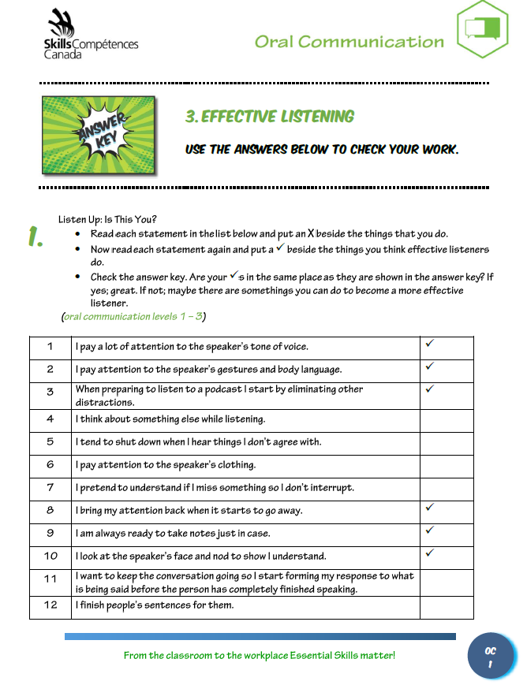
Answer Key
Notes:
Answer keys allow learners to determine how they did on the tasks.

Slide 30
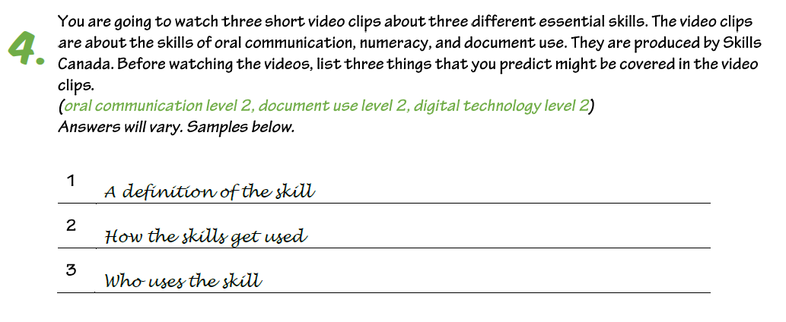
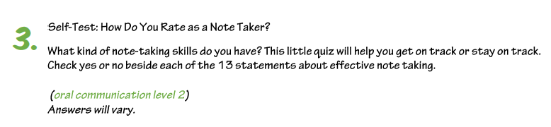
Answer Key
Notes:
For Workouts at higher complexity levels, such as those that require learners to research and enter their own findings, where possible, sample answers are given, consistent with the parameters of the task.
There will be a note saying Answers will vary. Sample answers shown below. If there are sample answers.
Otherwise the answer key will note that Answers will vary.

Slide 31
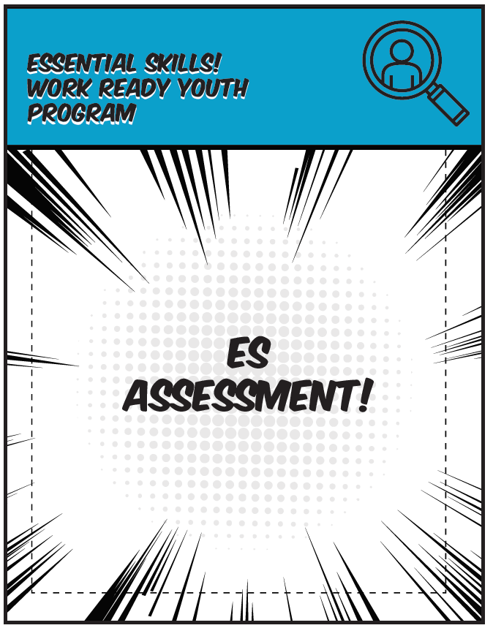
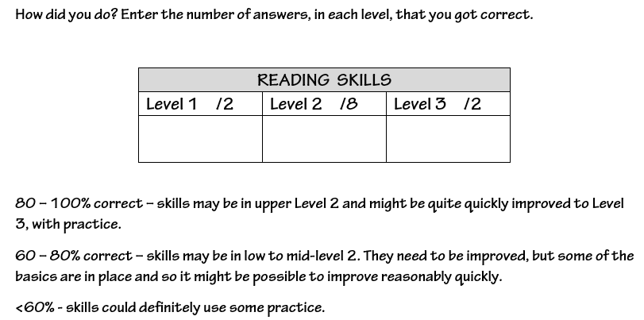
ES Assessment
Notes:
At the end of each workbook, you have the opportunity to complete a short informal assessment that provides a very general idea of how strong your skills are, related to the essential skill in that workbook.
There are between 11 and 14 multiple choice questions in total.
After you finish the questions, you can check on how you did in the assessment answer key that follows the questions. Then you can write the number of correct answers you got at each level and calculate how you did overall.
Remember, these are just very general estimations of skill. You are not completing enough questions to arrive at a truly accurate skill level.

Slide 32
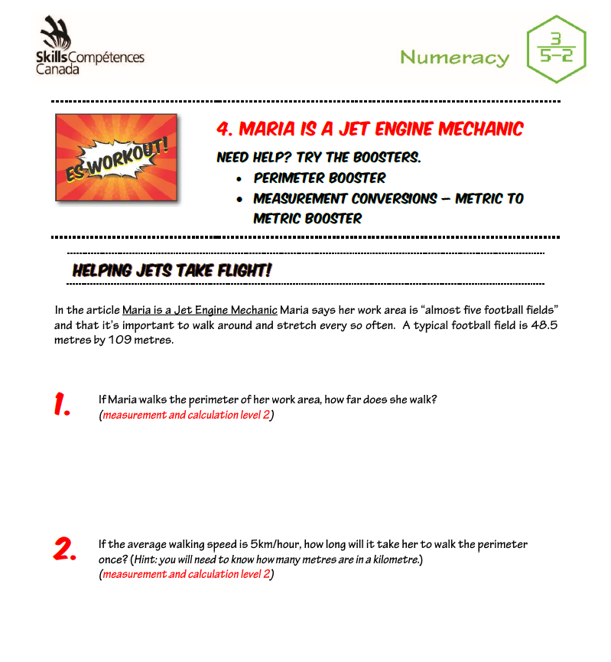
Try an ES Workout
Notes:
This activity is from the Numeracy workbook. It is based on a story about a young woman who became a jet engine mechanic.
In the story she describes the size of her work space.
Note that there are two Boosters listed that could help you to answer the questions, if you are not sure about them.
What do you think are the correct answers to the two questions above?

Slide 33
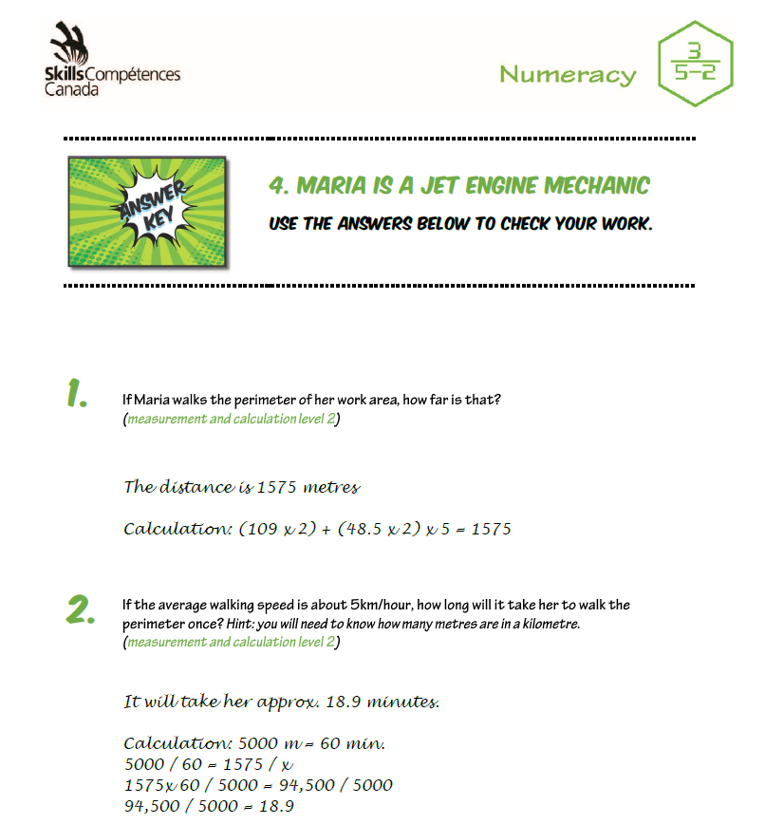
Try an ES Workout
Notes:
These are the answers in the answer key for the two questions you tried.
How did you do?

Slide 34
To learn More About Essential Skills
Skills/Compétence Canada
http://skillscompetencescanada.com/en/essential-skills/
The Job Bank
https://www.jobbank.gc.ca/report_skillknowledge-eng.do?action=search_form
Employment and Social Development Canada, Office of Literacy and Essential Skills
https://www.canada.ca/en/employment-social-development/programs/essential-skills.html

