Slide 1


Skills for Success
Conclusion

Slide 2

Start with an activity
Activity 1 My Resume
Activity 2 The Interview
Notes:
Select one of the ‘Conclusion’ activities from the Activities Booklet.

Slide 3

Skills for Success are a major component of Skills / Compétences Canada. Let's take a closer look at the 9 Skills for Success.
Notes:
Review the list of 9 Skills for Success. Definitions should be available to students from the activity.

Slide 4
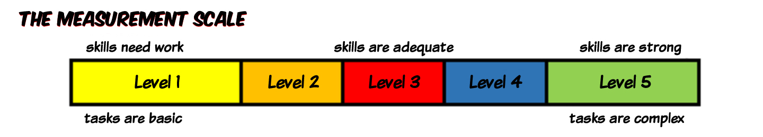



The 9 Skills for Success are the foundation for learning.
They are used to different degrees (or levels of complexity) in areas of work, learning and life.
Skilled Trades Office Job Training
Notes:
Skills for Success are developed through planned, regular and continued practice. These essential skills help us to be efficient and adaptable and to carryout complex activities or job tasks involving ideas, things, and/or people. Explain to students that the level of essential skills required for most trades is as high, or higher, than it is for many office jobs. So, what does that mean? Having strong essential skills means learners in the trades are better prepared to understand and remember concepts introduced in technical training.

Slide 5

Setting you up for success
Adaptability
Collaboration
Communication
Creativity & Innovation
Digital
Numeracy
Problem Solving
Reading
Writing
Notes:
Explain that the Skills for Success are used to navigate our daily lives and the world of work and the allow us to keep learning so we don’t get left behind. They are interconnected in many ways as we have seen in many of the Skills for Success Activities. For example, problem solving is supported by creativity and innovation; collaboration is supported by communication. Communication goes hand in hand with writing and reading skills. Etc.

Slide 6


Cool Jobs that require Skills for Success ...
Skilled Trades
https://www.youtube.com/watch?v=s6ZLBxDBPGQ
Notes:
Play video. Conclude by telling students that skilled trades are in high demand and essential across all communities in Canada. Working in the trades can be a very rewarding career option. Students can learn more about Skilled Trades on the Government of Canada website.

